Slide 1
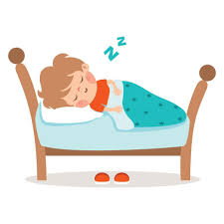
The Importance of Sleep
CSM website

Slide 2

Good websites for information
https://kidshealth.org/en/parents/sleep.html
https://www.aboutkidshealth.ca/sleep-benefits-and-recommended-amounts-for-children

Slide 3

Key Information
Recommended amount of sleep for kids including nap The recommended amount of sleep is simply a guideline, as each child is different. Sometimes your child might need a little more sleep than what is recommended and other times they may feel fine with a little less.
Age | Recommended amount of sleep
Newborns (0 to 3 months)​ | 14 to 17 hours (3 to 4 hours at a time)
Babies (4 to 11 months) | ​12 to 15 hours
Toddlers (1 to 2 years) | ​11 to 14 hours
Pre-schoolers (3 to 5 years) | ​10 to 13 hours
School-aged children (6 to 13 years) | 9 to 11 hours
Teenagers (14 to 17 years) | 8 to 10 hours

Slide 4
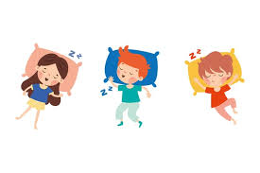
Key Information
Lack of sleep causes irritability, increased stress, forgetfulness, difficulties with learning and low motivation. Over time, it can contribute to anxiety and depression.
Sleep time guidelines depend on a child's age. Every child is different, so take time to figure out what works best for your child.

Slide 5

Benefits of Sleep
Children who consistently get a good night’s sleep:
are more creative
can concentrate on tasks for longer
have better problem-solving abilities
are better able to make positive decisions
are more able to learn and remember new things
have more energy during the day

Slide 6
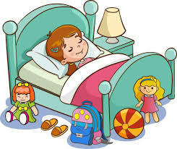
Some Signs and Symptoms of Lack of Sleep
Finding it difficult to wake up in the morning
Complaining of feeling tired or wanting to nap during the day
Preferring to lie down during the day, even if it means missing activities with friends or family
Hard time learning new information
Forgetfulness
Increased irritability

